Slide 1
Automated Honey Extractor
Group 3
Brandon Parmeter
Dmytro Boichev
Kira Farney
Petr Boychev

Slide 2
Motivation
Beekeeping equipment, honey extractors in particular are very expensive.
Current lower-end beekeeping machinery (under $1500) is severely lacking in terms of performance.
The honey extraction process is too time consuming compared to other beekeeping duties.

Slide 3
Current Extractor Used

Slide 4
Goals and Objectives
Design and build a high performance automated honey extractor.
Extract honey with minimal input from the user.
Optimize and decrease time consumption of the honey extraction process.
Achieve the previous goal in under $1000.

Slide 5
Specifications
Component | Design Specification
Frame Holder | The extractor shall support at least 8 frames
Vat | The extractor shall have a vat of at least 10 gallons
Heating System | The heating system shall heat up the honey to no more than 40 degrees Celsius
Motor | The motor should spin the frame holder up to 300 RPM.
Wireless Connectivity | The extractor shall be able to be operated wirelessly from a distance of at least 5 feet

Slide 6
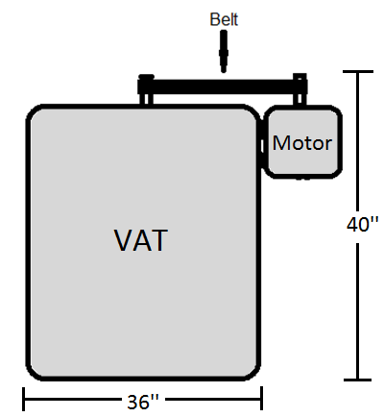
Mechanical Characteristics
The frame holder is currently 31’’ tall and 16’’ in radius.
The honey extractor is
estimated to be 40’’
tall and 36’’ wide.

Slide 7
Frame Holder

Slide 8
Block Diagram

Slide 9
Heating System

Slide 10
Heating System
The heating system will speed up the extraction process by decreasing honey viscosity.
Micro Controller
Temperature
Sensor
Heating Coil
Heating Coil Driver

Slide 11
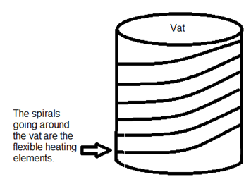
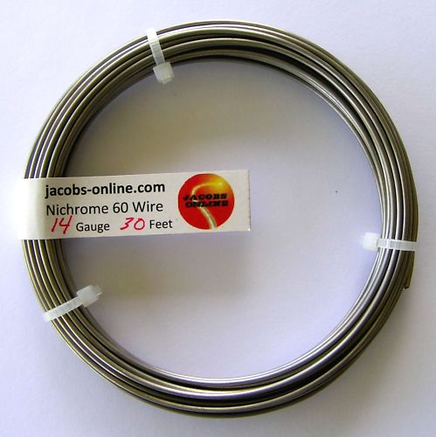
Heating Element
Nichrome Wire
Gauge 14 (0.064 inch diameter)
Can be heated up to 900 ºC
Resistivity of 0.165 ohms/ft

Slide 12
Sensors

Slide 13
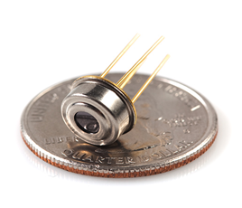
Temperature Sensor
An infrared temperature sensor will provide feedback information to the heating system.
The sensor provides a convenient way to measure the temperature inside of the vat with spinning components.
MLX90614
Temp range: -40°C ~ 125°C
Voltage: 4.5 V ~ 5.5 V
Accuracy: ±1°C

Slide 14
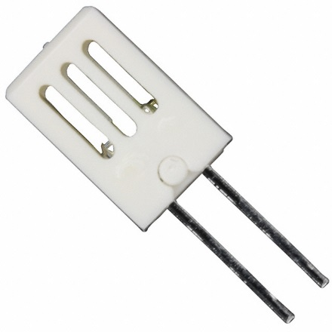
Humidity Sensor
Water content of the honey is affected by the humidity level during extraction.
High water content negatively affects the quality of the honey (leads to fermentation).
HCH-1000-002
Humidity Range: 0 ~ 100% RH
Operating Temp: -40°C ~ 120°C
Accuracy: ± 2% RH

Slide 15
Motor Controller

Slide 16
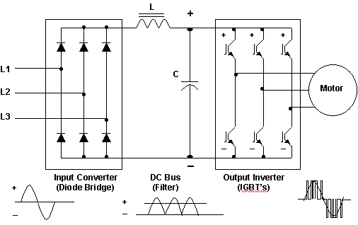
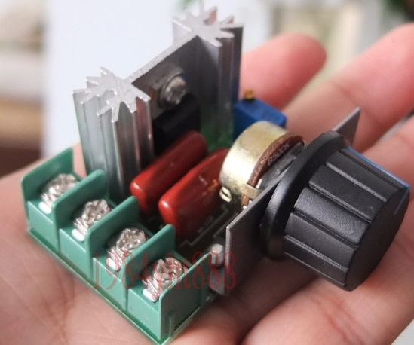
Motor Controller
Required motor output: ¼ HP
AC motor used for availability of electrical power
Variable Frequency drive to slowly bring frame holder to extraction speed

Slide 17
Human Interface Device

Slide 18
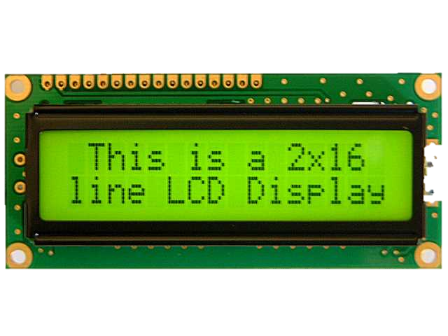
Human Interface Device
2 x 8 segment outdoor LCD display
Read sensor data
Other feedback from MCU
Weatherproof Buttons and switches
Used to turn on and off device
Selects various operating modes
Select what is displayed on LCD

Slide 19
Remote Control with Android
Purpose:
control remotely
monitor temperature and humidity
Android development
The lowest version of Android 2.2 (SDK 8)
The target SDK for which we will be developing is Android 4.3

Slide 20
Remote Control with Android (cont.)

Slide 21
Remote Control with Android (cont.)
Bluetooth RN42 EK module
Size 44.5 x 23.0 x 5.0 mm
Operating range is up to 20 m
Frequency 2,402 ~ 2,480 MHz
Connects directly to a PC via a standard USB interface or to embedded processors through the TTL UART interface

Slide 22
Remote Control with Android (cont.)

Slide 23
Microcontroller

Slide 24
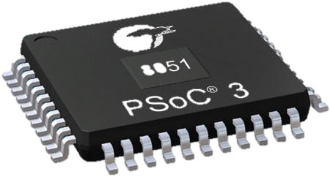
Microcontroller
PSoC 3
Delta Sig ADC
8-bit 8Msps DAC
Integrated LCD Driver
62 GPIO Pins
1.5 – 5.5 V operating range
Cheap $4.33

Slide 25
Power Supply

Slide 26
Power Supply
Standard Wall Outlet 120V @60 Hertz
Component | Voltage | Current | Type
Motor | 115 V | 5A | AC
Heating Element | 12 V | 5A | DC
MCU | 5 V | >1A | DC

Slide 27
Administrative Content

Slide 28
Work Distribution
 | Brandon | Dmytro | Kira | Petr
Mechanical |  | X |  | X
Software | X |  | X
MCU | X
Power Supply | X |  |  | X
Heating System |  | X |  | X
Sensors |  | X
BlueTooth |  |  | X
Motor | X |  |  | X

Slide 29
Budget
Part | Cost
Humidity Sensor | $8.64
Infrared Temperature Sensor | $19.12
LCD Display | $17.50
Motor | $73
Motor Controller | $100
Power Supply | $50
Microcontroller | $16.24
BlueTooth Module | $45.34
Nichrome Wire | $21
Valve | $12
Total | $362.84

Slide 30
Progress

Slide 31
Current Issues
Mechanical parts are too heavy, trying to decrease weight.
Expecting more challenges to occur as we continue prototyping.

Slide 32
Questions?

